Slide 1
CHAPTER-7
Documentation Hypertext and MHEG

Slide 2
Contents
7.1 Document architecture and multimedia integration
7.2 Hypertext, hypermedia and multimedia
7.3 Hypermedia System: Architecture, nodes and pointers document
7.4 Architecture: SGML, ODA and MHEG

Slide 3
7.1 Document architecture and multimedia integration
Document:
A document consists of a set of structural information that can be in different forms of media and during presentation can be generated or recorded.
A document is aimed at the perception of human and is accessible for computer processing.
Multimedia Document:
A multimedia document which comprised of information coded in at least one continuous (time-dependent) medium and in one discrete (time-independent) medium.
Integration of the different media is given through a close relation between information units. This is also called synchronization.

Slide 4
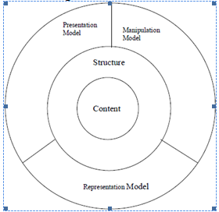
Document Architecture
It describe the connection among the individual elements represented as model (e.g. Presentation model, manipulation model).
Fig. Document architecture and its elements.

Slide 5
Content:
multi- / monomedia information
Structure:
spatial and temporal relations between information
Manipulation Model:
operation allowed for creation, change and deletion of information
Representation Model:
exchange protocol and data format
Presentation Model:
rules for document presentation

Slide 6
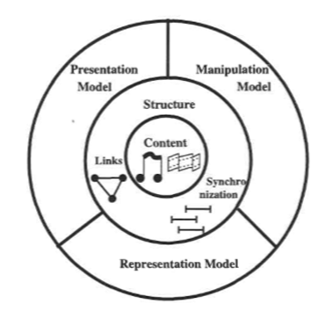
Figure: - a multimedia documents architecture and its constituent elements

Slide 7
7.2 Hypertext, hypermedia and multimedia
Hypertext:
It refers to the use of hyperlink or simply links to present text and graphics.
It represents a relatively recent innovation to user interfaces, which overcomes some of the limitations of written text. Rather than remaining static like traditional text, hypertext makes possible a dynamic organization of information through links and connections (called hyperlinks).
Hyperlink: It is the link from a hypertext document to another location, activated by clicking on a highlighted works as image.
Types and uses of hypertext
Static: prepared and stored in advance
Used to cross-reference collections of data in documents, software applications, or books on CD.
Dynamic: continually changing in response to user input

Slide 8
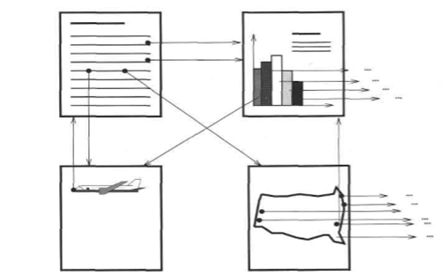
Example of Hypertext:
Figure: Hypertext data: An example of linking information of different media.
Note: The most famous implementation of hypertext is the World Wide Web.

Slide 9
Hypertext System:
A hypertext system is mainly determined through non-linear links of information.
It is the system that allows to read hypertext document non-linearly.
Pointers connect the nodes. The data of different nodes can be represented with one or several media types. In a pure text system, only text parts are connected.
Multimedia System:
It contains information which is coded at least in a continuous and discrete medium.
For example, if only links to text data are present, then this is not a multimedia system, it is a hypertext. A video conference, with simultaneous transmission of text and graphics, generated by a document processing program, is a multimedia application.

Slide 10
Hypermedia System:
It is the combination of hypertext system and multimedia system.
It is used as a logical extension of the term hypertext, in which graphics, audio, video, plain text and hyperlinks intertwine to create a generally nonlinear medium of information.
This contrasts with the broader term multimedia, which may be used to describe non-interactive linear presentations as well as hypermedia.
Example: World Wide Web
Most modern hypermedia is delivered via electronic pages from a variety of systems. Audio hypermedia is emerging with voice command devices and voice browsing.

Slide 11
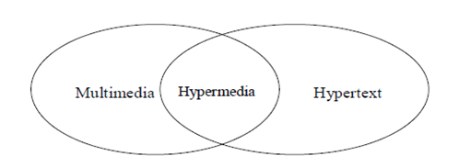
Fig. The hypertext, hypermedia and multimedia relationship

Slide 12
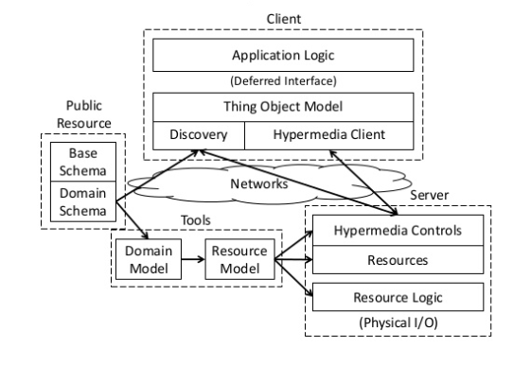
7.3 Hypermedia System: Architecture, nodes and pointers document
Fig: Hypermedia System Architecture

Slide 13
Anchor:
Anchors are link ends (origin or destination of a hyperlink) like text parts, graphic area or temporal position of audio/ video stream.
At the user interface the origin of pointers must be marked, so that the user can move to a further information unit. This origin of a pointer is called an anchor.
The representation of anchor in a user interface should following properties.
A media-independent representation can happen through the selection of general graphical elements, such as buttons.
In a text, individual words, paragraphs or text sections of different length can be used for representation.
In Images specific graphical objects or simply areas are defined as selection object.
In motion video, media-independent representations of the anchor are preferred.
With respect to audio, a media-independent solution is used.

Slide 14
Node: It is the information unit of a hypertext document.
Pointer link: Edges of a hypertext graph. Types of pointer are:
Simple pointers link two nodes of the graph without containing any further information.
Typed pointers include, in addition to the link between two nodes, further information. Each pointer gets a label.

Slide 15
7.4 Architecture: SGML, ODA and MHEG
Document Architecture: SGML
The Standard Generalized Markup Language (SGML)
Authors prepare the text, i.e., the content. They specify in a uniform way the title, tables, etc., without a description of the actual representation (e., script type and line distance). The publisher specifies the resulting layout.
SGML specifies the syntax, but not the semantics.
For example,
<title>Multimedia-Systems</title>
<author>Felix Gatou</author>
<side>IBM</side>
<summary>This exceptional paper from Peter…
This example shows an application of SGML in a text document.
Example: HTML (Hypertext markup language)
Markup language: the code is used to specify the formatting is called as tags.

Slide 16
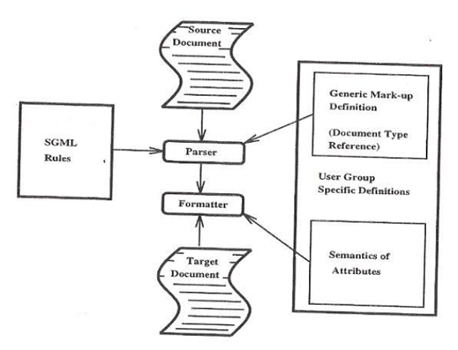
Fig. SGML : Document processing – from the information to the presentation
The following figure shows the processing of an SGML document. It is divided into two processes: i) Parser ii) Formatter

Slide 17
Parser: It uses the tags, occurring in the document, combination with the corresponding document type.
Formatter: It knows the meaning of tags and it transforms the document into a formatted document.
Notes:
Compiler or interpretter component that breaks data into smaller elements for easy translation into another language

Slide 18
Document Architecture: ODA
Open Document Architecture ODA
Initially called the Office Document Architecture because it supports mostly office-oriented applications.
Main goal: To support the exchange, processing and presentation of documents in open systems.
It is a free and open international document file format maintained by ITU-T to replace all proprietary document file format.
The main property of ODA is the distinction among content, logical structure and layout structure.
This is a contrast to SGML where only a logical structure and the contents are defined ODA defines semantics.

Slide 19
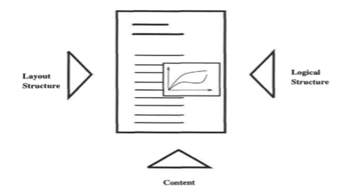
Figure: - ODA: Content, layout and logical view
The above figure shows three aspects (content, logical structure and layout structure) linked to a document.

Slide 20
Content:
The content of the document consist of content portions.
Layout Structure:
The layout structure specifies mainly the representation of a document.
It is related to a two dimensional representation.
Logical Structure:
It includes the partitioning of the content.

Slide 21
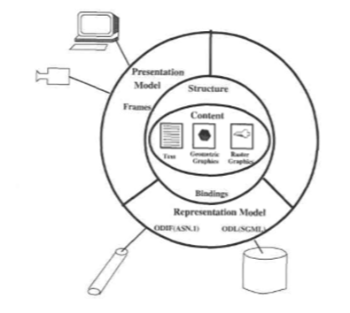
Figure: ODA information architecture with structure, content, presentation and representation model

Slide 22
Document Architecture: MHEG
Multimedia and Hypermedia Information Expert Group
It specifies an encoding format for multimedia applications independently of service paradigms and network protocols.
Goals:
to provide a simple but useful and easy to implement framework for multimedia application.

Slide 23
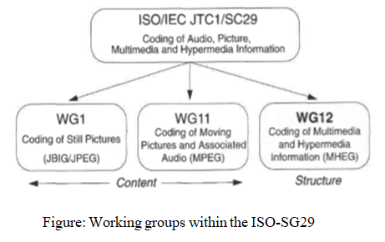

Slide 24
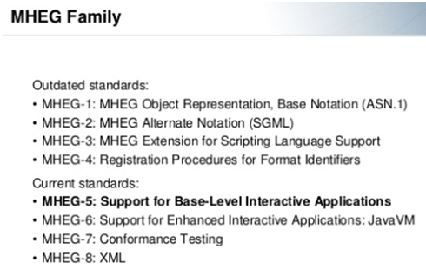
Versions of MHEG:

